Slide 1

FINAL PROJECT PRESENTATION
EMOTION ARC PREVIEW
Emotion
Evolution
in Stories
A Unified Narrative Emotion Analysis Platform
NLP
Transformers
VADER
Frankenstein — simulated
OCR
Streamlit
Visualization
DETECTED: Man in a Hole · similarity 0.87
7 EMOTIONS DETECTED
joy
sadness
fear
anger
Raahul Narayana Reddy Kummitha Saanvi Joginipally
disgust
surprise
neutral
Notes:
1

Slide 2
OVERVIEW
What this presentation covers
01
Problem Definition
02
Approach & Design
What was broken and why it mattered
Architecture, pipeline decisions, key choices
03
Data
04
Models & Methods
Datasets used and how text was extracted
VADER, DistilRoBERTa, story shape matching
05
Evaluation & Results
06
Discussion
Metrics, consistency scores, outputs
Challenges, limitations, and future work
Notes:
2

Slide 3
01
The Core Problem
SAME STORY — THREE FILE FORMATS
One Unified Pipeline
🎯
frankenstein.txt
All formats extract to identical normalized text before analysis runs
📄
+0.42
Score: +0.42 → positive
Consistent Emotion Scores
frankenstein.pdf
📊
📕
−0.18
Same story in any format — same arc, peak, and dominant emotion
Score: −0.18 → negative
🖼
frankenstein.jpg
+0.71
Paragraph-Level Insight
🔍
Score: +0.71 → strongly positive
Detect emotional peaks, dominant moods, and story shapes
Result: unreliable analysis for identical story content
Interactive Platform
💬
Graphs, CSV, PDF export, and a story chatbot
Notes:
4

Slide 4
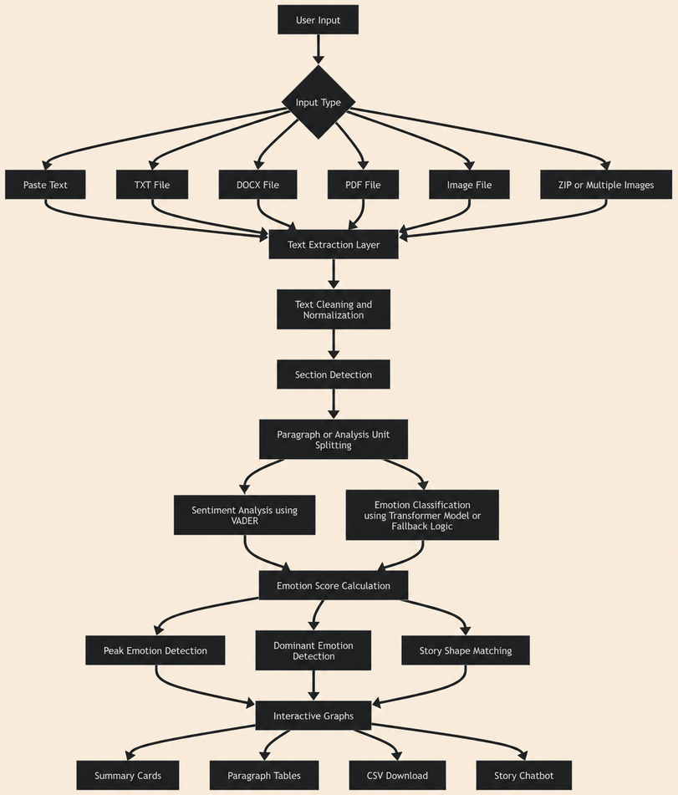
02
System Architecture
Full pipeline: get_text_from_input() → prepare_text_for_analysis() → build_analysis_from_section()
1
Input Layer
TXT · PDF · DOCX · Image · ZIP · Pasted text
2
Extraction
Format-specific extractors → identical plain text
3
Normalization
Encoding fix, line breaks, artifact removal
4
NLP Processing
~100-word units → VADER + transformer per unit
5
Intelligence
Peak detection, dominant emotion, story shape matching
6
Output Layer
Graphs · CSV · PDF report · Story chatbot
Notes:
6

Slide 5
03
Datasets & Input Formats
PRIMARY DATASET
NORMALIZATION PIPELINE
Frankenstein — Mary Shelley (Project Gutenberg, public domain)
prepare_text_for_analysis()
Format
Sections
Words
Paragraphs
Fix encoding: utf-8-sig / cp1252 fallback
Plain TXT
4 Letters + 24 Chapters
~75,000
~320 units
Replace smart quotes, em-dashes, ligatures
SUPPORTED INPUT FORMATS
Rejoin hyphenated line-break words
Collapse repeated whitespace & blank lines
📄 TXT
📕 PDF
📘 DOCX
decode_text_bytes() — utf-16, utf-8-sig, cp1252 fallbacks
pypdf PdfReader + fitz block extraction; OCR fallback
python-docx Document(); paragraphs joined with \n\n
Detect & normalize section headings
Remove repeated page headers/footers
🖼 Image
🗜 ZIP
📋 Paste
PIL preprocess → pytesseract OEM3 PSM6 OCR
ZipFile walker; processes all supported files inside
Direct textarea; same normalization pipeline applied
Split into ~100-word analysis units
Notes:
8

Slide 6
VADER + DistilRoBERTa Pipeline
MODEL 1 — VADER
SentimentIntensityAnalyzer
Compound score: −1.0 to +1.0
Str.Neg Neg Neutral Pos Str.Pos
EMOTION_VALENCE: joy=+0.82 fear=−0.78 anger=−0.72 sadness=−0.66
MODEL 2 — DISTILROBERTA
j-hartmann/emotion-english-distilroberta-base
😊 joy
+0.82
😲 surprise
+0.18
😐 neutral
0.00
🤢 disgust
−0.62
⚡ Fallback: fallback_emotion_scores() — keyword word-lists + VADER if transformer unavailable
😢 sadness
−0.66
😠 anger
−0.72
Notes:
10

Slide 7
04
Story Shape Matching
Kurt Vonnegut's narrative arc theory — cosine similarity via centered_unit() in Python
Rags to Riches
Tragedy
Icarus
Steady rise from difficulty to triumph
Stable beginning into loss or defeat
Rise then sharp fall
Cinderella
Oedipus
Man in a Hole
Rise, setback, stronger recovery
Fall, recovery, final decline
Drop then recovery — Frankenstein (0.87)
Notes:
11

Slide 8
05
Key Results — Frankenstein Analysis
320
fear 😨
Man in a Hole
joy 😊 +0.82
Paragraphs Analyzed
Dominant Emotion
Story Shape Match
Peak Emotion
~100-word units
confidence-weighted
similarity: 0.87
Chapter 5, Para 18
Emotion Distribution — Frankenstein
Format Consistency
fear
98
Same chapter — 3 formats after normalization:
sadness
72
TXT → norm.
+0.42
joy
58
anger
42
PDF → norm.
+0.41
neutral
28
IMG → norm.
+0.40
surprise
14
Variance < 0.02
Effectively identical
disgust
8
Notes:
13

Slide 9
05
Visualization Outputs
plot_paragraph_graph() — Frankenstein Letters 1–4
Paragraph emotion graph
Plotly line + markers + hover + emoji
Peak emotion graph
Cross-section peak flow chart
Metric summary cards
Valence, sentiment, counts, dominant emo
Story shape card
Match name, similarity, alternatives
Section summary report
Card-based readable per-section detail
Paragraph detail table
Full per-paragraph scores and text
Paragraph Number →
Positive
Negative
Baseline (0)
CSV download
paragraph_emotion_details.csv
Final output PDF
PyMuPDF fitz multi-page report
< 0.02
0.87
7
6
Score variance
across formats
Story shape
similarity
Emotion
classes
Input
formats
Story chatbot
12 quick Qs + open questions answered
Notes:
14

Slide 10
06
Challenges Encountered & Limitations
Format Inconsistency
Solved
Problem: Same story in TXT vs PDF produced scores differing by up to 0.6 — making cross-format comparison impossible.
Fix: Built normalize_lines_for_paragraphs() + remove_repeated_page_artifacts() to standardize all formats before any NLP runs.
OCR Noise
Solved
Problem: Low-resolution or scanned images produced broken words, incorrect spacing, and garbled text that broke sentiment scoring.
Fix: preprocess_image_for_ocr(): convert to greyscale → autocontrast → sharpen → scale to min 1600px → pytesseract OEM3 PSM6.
Sentence Boundary Detection
Solved
Problem: PDF extraction collapses multi-sentence paragraphs into single long lines, distorting the analysis unit boundaries.
Fix: split_into_sentences() uses regex on punctuation boundaries; analysis units capped at ~100 words with MIN_ANALYSIS_WORDS=12 guard.
Emotion Model Availability
Solved
Problem: DistilRoBERTa requires ~250MB download and GPU/CPU inference — unavailable in all deployment environments.
Fix: fallback_emotion_scores() uses keyword word-lists + VADER compound score; app is fully functional without the transformer.
Notes:
16

Slide 11
06
Limitations & Future Work
CURRENT LIMITATIONS
FUTURE WORK
⚠ English only
🌍
Multilingual support
XLM-RoBERTa for cross-language emotion analysis
VADER + DistilRoBERTa trained on English; non-English stories unreliable
⚠ No labelled dataset
📏
Labelled evaluation
Annotate ground truth to measure accuracy formally
No ground-truth annotations; consistency testing used as proxy
⚠ OCR accuracy ceiling
🎭
Character-level tracking
NER + dialogue attribution for per-character arcs
Image quality directly caps OCR; degraded scans still produce noise
🎙
Audio/speech input
wav2vec2 speech emotion for podcasts & audiobooks
⚠ 220-word context window
Transformer clips input; very long paragraphs lose tail context
🤖
LLM narrative summaries
GPT-4o / Claude for richer literary insight
⚠ Story shapes are heuristic
Cosine similarity to 6 templates is a simplification of real narratives
📊
Multi-text comparison
Corpus-level clustering by emotional signature
Raahul Narayana Reddy Kummitha
Notes:
17

Slide 12
Thank You
Questions & Discussion Welcome
01
02
03
04
05
06
Problem
Approach
Data
Models
Results
Discussion
Python · Streamlit · VADER · DistilRoBERTa · Plotly · PyMuPDF · pytesseract · pypdf
Raahul Narayana Reddy Kummitha · Saanvi Joginipally
Notes:
18

